Slide 1
Statistics Concepts
Instructor: Gulshan yasmeen

Slide 2
What is Statistics?
Statistics is the branch of mathematics that deals with collecting, analyzing, interpreting, and presenting data.
• Helps summarize large data into meaningful information.
• Example: Calculating the average marks of a class.

Slide 3
What is Data?
Data: Raw facts and figures collected for analysis.
Types:
• Structured Data – Organized (tables, databases).
• Unstructured Data – Unorganized (text, images, videos).
Example: Student grades in a table vs. student feedback comments.

Slide 4
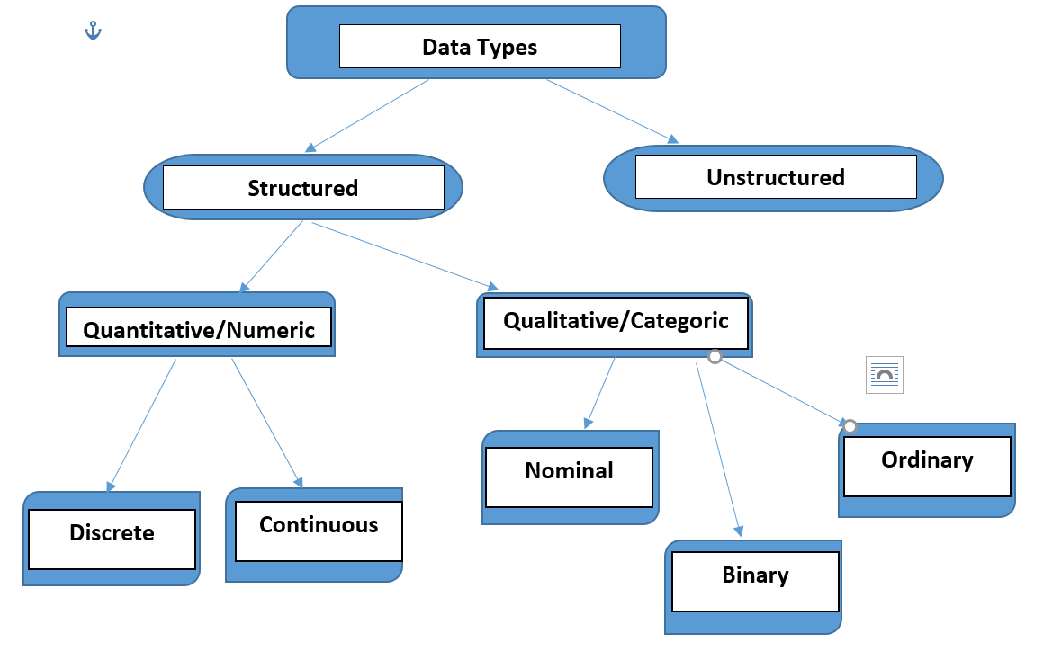
Types of Data

Slide 5
Types of Data
Data can be divided into two broad categories:
Structured Data (organized, in rows/columns like databases, spreadsheets).
Unstructured Data (raw formats like images, audio, text, videos).
1. Quantitative Data (Numerical)
• Discrete – Countable values (No. of students).
• Continuous – Measured values (Height, Weight).
2. Qualitative Data (Categorical)
• Nominal – Names/labels (Gender, Color).
• Ordinal – Ordered categories (Rank, Grades).
• Binary – Two categories (Yes/No).

Slide 6
Types of Statistics
1. Descriptive Statistics – Summarizes data using measures like mean, median, variance.
Example: Average height of students in a class.
2. Inferential Statistics – Makes predictions or inferences about a population using samples.
Example: Predicting election results using survey data.

Slide 7
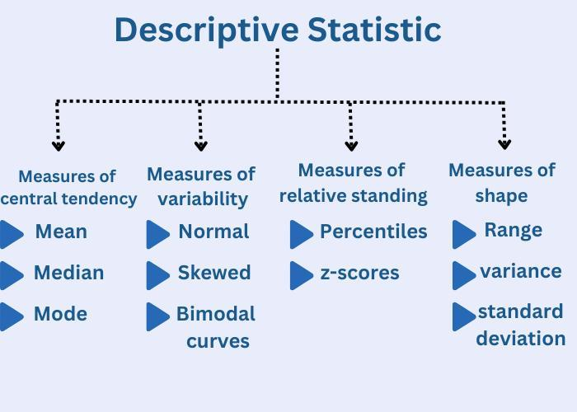
Descriptive Statistics

Slide 8
Measures of Central Tendency
Central tendency refers to measure used to determine the center of distribution of data.
• Mean – The average of values.
Example: (10 + 20 + 30) / 3 = 20
• Median – The middle value when data is ordered. Useful if we have outliers
Example: [1, 3, 5, 7, 9] → Median = 5
• Mode – The most frequent value. Works well with the categorical data
Example: [2, 2, 3, 4] → Mode = 2
E.g In marketing: Find the most purchased product.
Notes:
use Mean for continuous, symmetrical numerical data where all values matter.

Slide 9

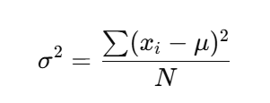
Measures of Dispersion
Dispersion used to measure spread of data.
• Range – Difference between maximum and minimum.
Example: [3, 7, 10] → Range = 10 - 3 = 7
• Standard Deviation – square root of variance.
E.g understanding variability in student scores.
In ML: used in feature scaling (z-score normalization).
• Variance– to calculate how far each data value in a dataset is from mean . Larger variance→more spread
where xi = each data point, μ = mean,
N = number of data points.
Notes:
• Coefficient of Variation – (Std Dev / Mean) × 100
• Skewness – Measure of asymmetry.
• Kurtosis – Measure of data peak/flatness.

Slide 10

Co-efficient of Variation
The Coefficient of Variation (CV) measures the relative variability of data. It is the ratio of the standard deviation (σ) to the mean (μ), usually expressed as a percentage.
CV is unitless (percentage), making it easy to compare across different datasets.
Usage & Importance:
Used to compare variability between datasets with different units/scales.
Helpful in finance (portfolio risk comparison), manufacturing (quality control), and data science (choosing stable features).

Slide 11
Co-efficient of Variation Vs Variance
Featureb | Variance | Coefficient of Variation
What it measures | Absolute spread around the mean | Relative spread compared to the mean
Formula | Avg. of squared deviations | (Standard Deviation ÷ Mean) × 100
Units | Squared units of data | Unitless (percentage)
Comparison | Only works for same-unit data | Can compare across different units/scales
Use | Describes data variability | Compares stability/consistency across datasets

Slide 12
Skewness and Kurtosis
Feature | Skewness | Kurtosis
What it measures | Asymmetry (left/right lean) | Tailedness (how extreme the outliers are)
Focus | Direction of outliers | Intensity of outliers
Example | Income distribution (positively skewed) | Stock returns (high kurtosis due to crashes/spikes)
Normal distribution | Skewness = 0 | Kurtosis = 3
Interpretation | Are outliers on one side? | Are there too many/few extreme outliers?

Slide 13
Measures of Position
tell us where a particular value lies in a dataset compared to others. They are useful for understanding relative standing.
• Z-Score – Number of standard deviations away from mean.
Example: Z = (X - Mean)/Std Dev
Example: If exam mean = 70, SD = 10, and you scored 90 → Z = (90−70)/10 = +2. (You are 2 standard deviations above average.)
• Percentile – Divide the data into 100 equal parts. Indicates relative standing.
Example: 90th percentile → scored better than 90%.
• Quartiles – Divide data into 4 equal parts.
• Interquartile Range (IQR) = Q3 - Q1.
Notes:
Quartiles in Data Science
Quartiles are used to summarize and analyze distributions of data. They split the dataset into 4 equal parts and are crucial for detecting spread, variability, and outliers.
📊 Example Dataset (Salaries of 10 employees in $1000s)
[25, 28, 30, 35, 40, 45, 50, 60, 80, 120]
Q1 (25th percentile): First 25% of values → 30
Q2 (50th percentile / Median): Middle value → 42.5
Q3 (75th percentile): 75% of values below this → 65
👉 Interpretation:
25% of employees earn less than $30k
50% earn less than $42.5k
75% earn less than $65k
Top 25% earn between $65k and $120k

Slide 14
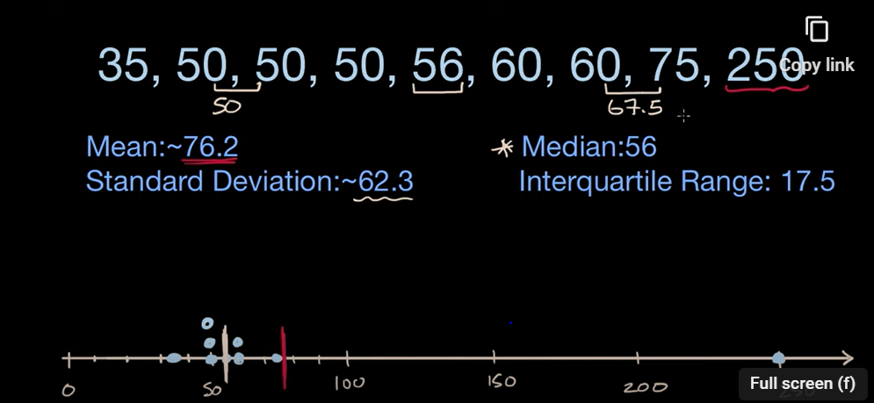
Measures of Position
• Interquartile Range (IQR) = Q3 - Q1.

Slide 15
Five Number Summary
The five-number summary gives a quick overview of how data is spread. It consists of these five values:
Minimum (Min): The smallest value.
Q1 (First Quartile): The value at the 25th percentile (25% of data lies below).
Median (Q2): The middle value (50th percentile).
Q3 (Third Quartile): The value at the 75th percentile (75% of data lies below).
Maximum (Max): The largest value.
Provides a simple, non-technical summary of data.
Basis for Boxplot, a common visualization.
Used in exploratory data analysis (EDA) to quickly detect skewness and outliers.
It helps you see the spread, skewness, and detect outliers in a dataset.

Slide 16
Applications in ML & Data Science
• Data understanding: Choosing correct algorithms depends on knowing data types.
• Feature scaling: Z-scores used in normalization.
• Model evaluation: Statistics used for hypothesis testing.
• Example: Predicting customer churn using structured + unstructured data.
• Example: Using variance to detect feature importance.

